Slide 1
The national enterprise «Holding managing company» «Belorussian cement company»

Slide 2
The holding «Belorussian cement company» is the leading manufacturer and supplier of building materials in the Republic of Belarus.
The holding includes three cement plants:
OJSC "Belorussian Cement Plant",
OJSC "Krichevcementnoshifer"
OJSC "Krasnoselskstroymaterialy"
and 23 factories producing products from reinforced concrete, gas silicate blocks, bricks and other products.

Slide 3
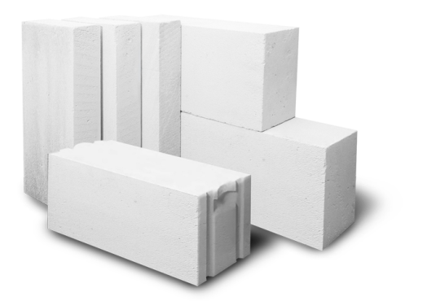
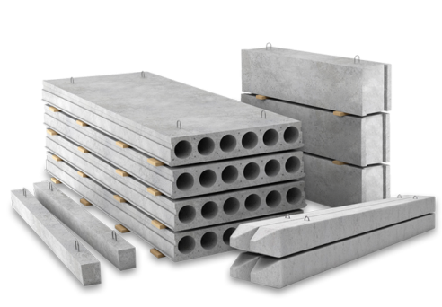
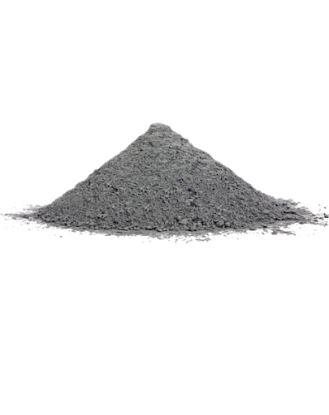
"Belorussian Cement Company" produces cement,
lime, silicate blocks and practically the whole range of reinforced concrete products: hollow core slabs, road slabs, piles, foundation blocks, lintels of all types, girders, beams, columns and other products.
Also in the range of products - building mixtures, chalk, bricks and thermal insulation materials.

Slide 4
The productive capacity of three cement plant is 8,7 million tons per year, including:
The productive capacity of enterprises within the holding
for other types of product per year:

Slide 5
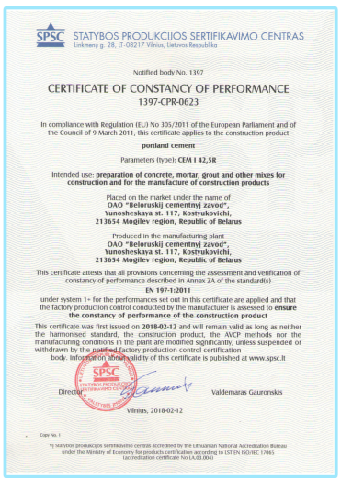
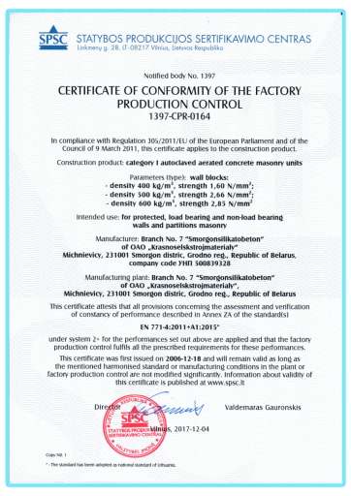
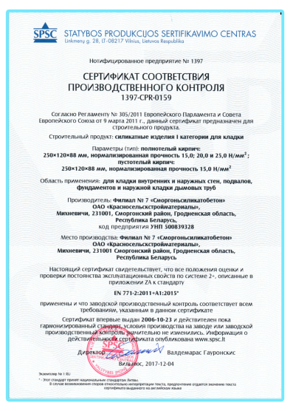
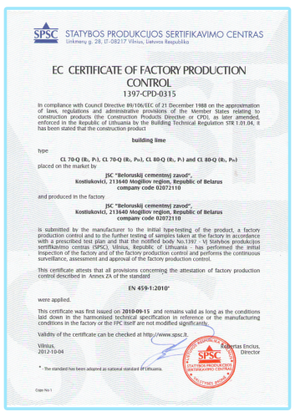
Conformity certificates of European Union (EU) for cement
European conformity certificates for:
wall blocks;
sand-lime bricks
building lime

Slide 6
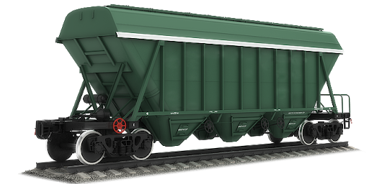
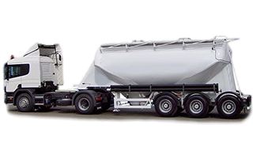
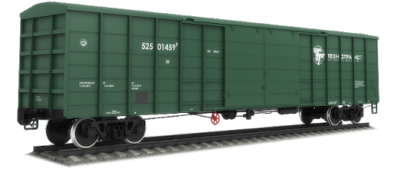
CEMENT and LIME
are supplied by all types of transport:
• in bulk form in tank trucks
• in bulk and packed form in wagons
Possibility of delivery to the port (Klaipeda)
Export of products is carried out in the following countries:
• the Russian Federation
• Lithuania
• Latvia
• Poland
• Hungary

Slide 7
The company's activity is based on three main principles:
• an individual approach to the client
• perfect quality of products
• accurate observance of liabilities

